Slide 1
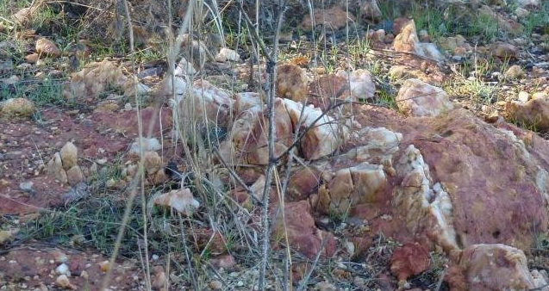
Mysteries 1.
Quartz reef in ironstone band on north shore Lake Tooliorook.

Slide 2
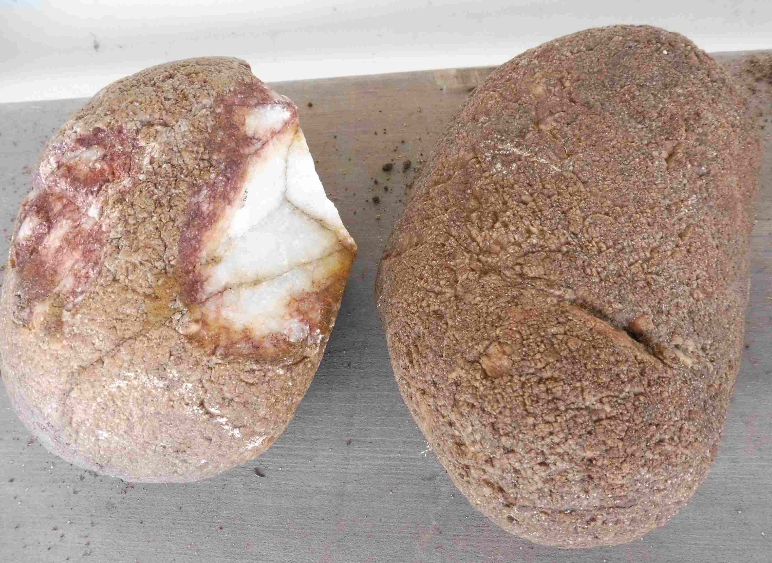
Mysteries 2
Contour line of smooth quartz stones on the “boomerang ridge”. Glacial origin?

Slide 3
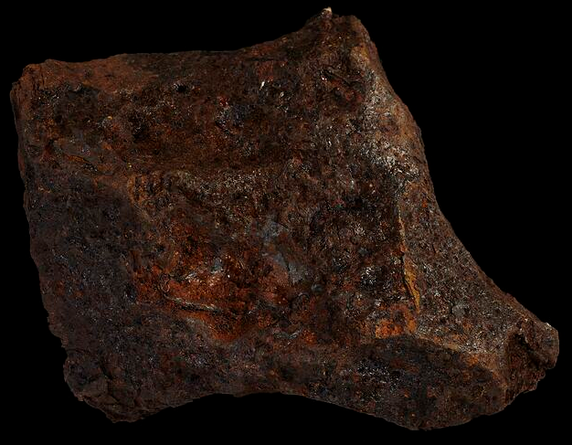
Lismore meteorite
https://collections.museumsvictoria.com.au/specimens/102
There are Australites too! There will be more of both about.

Slide 4
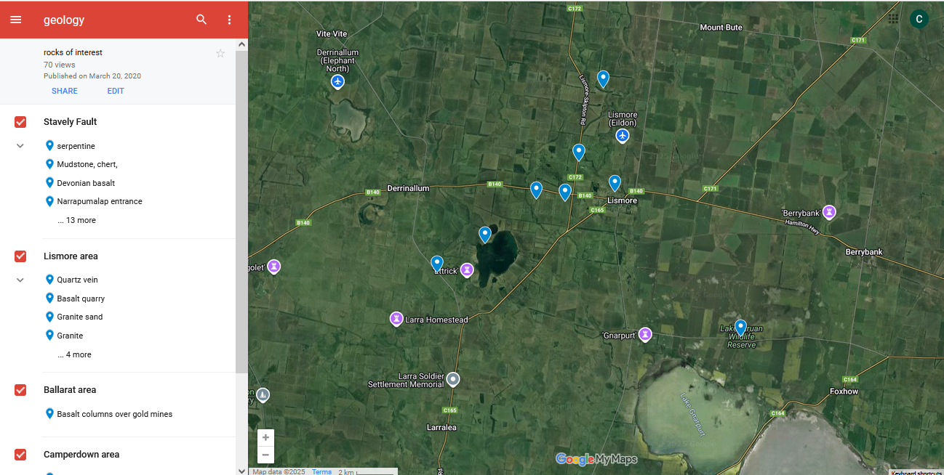
Location map https://www.google.com/maps/d/viewer?mid=1docCenvW9krRqHhvmOdtA7AlgHBWGShI&hl=en&usp=sharing Tick the red boxes, click on the blue flags for details and photos.

Slide 5
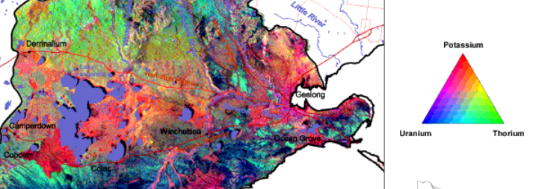
Radiometrics
vic.gov.au/dpi/vro/coranregn.nsf/pages/cor_radiometrics_map
Proportion of Uranium (basalt), Potassium (Granite), Thorium radiation.(laterite)

Slide 6
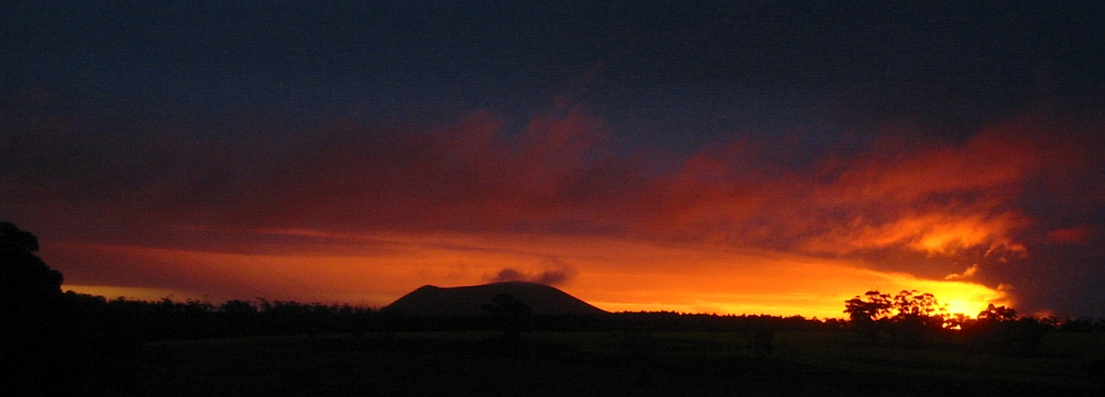
Thanks.
We are lucky to live at a quiet time!
Notes:
6

Slide 7
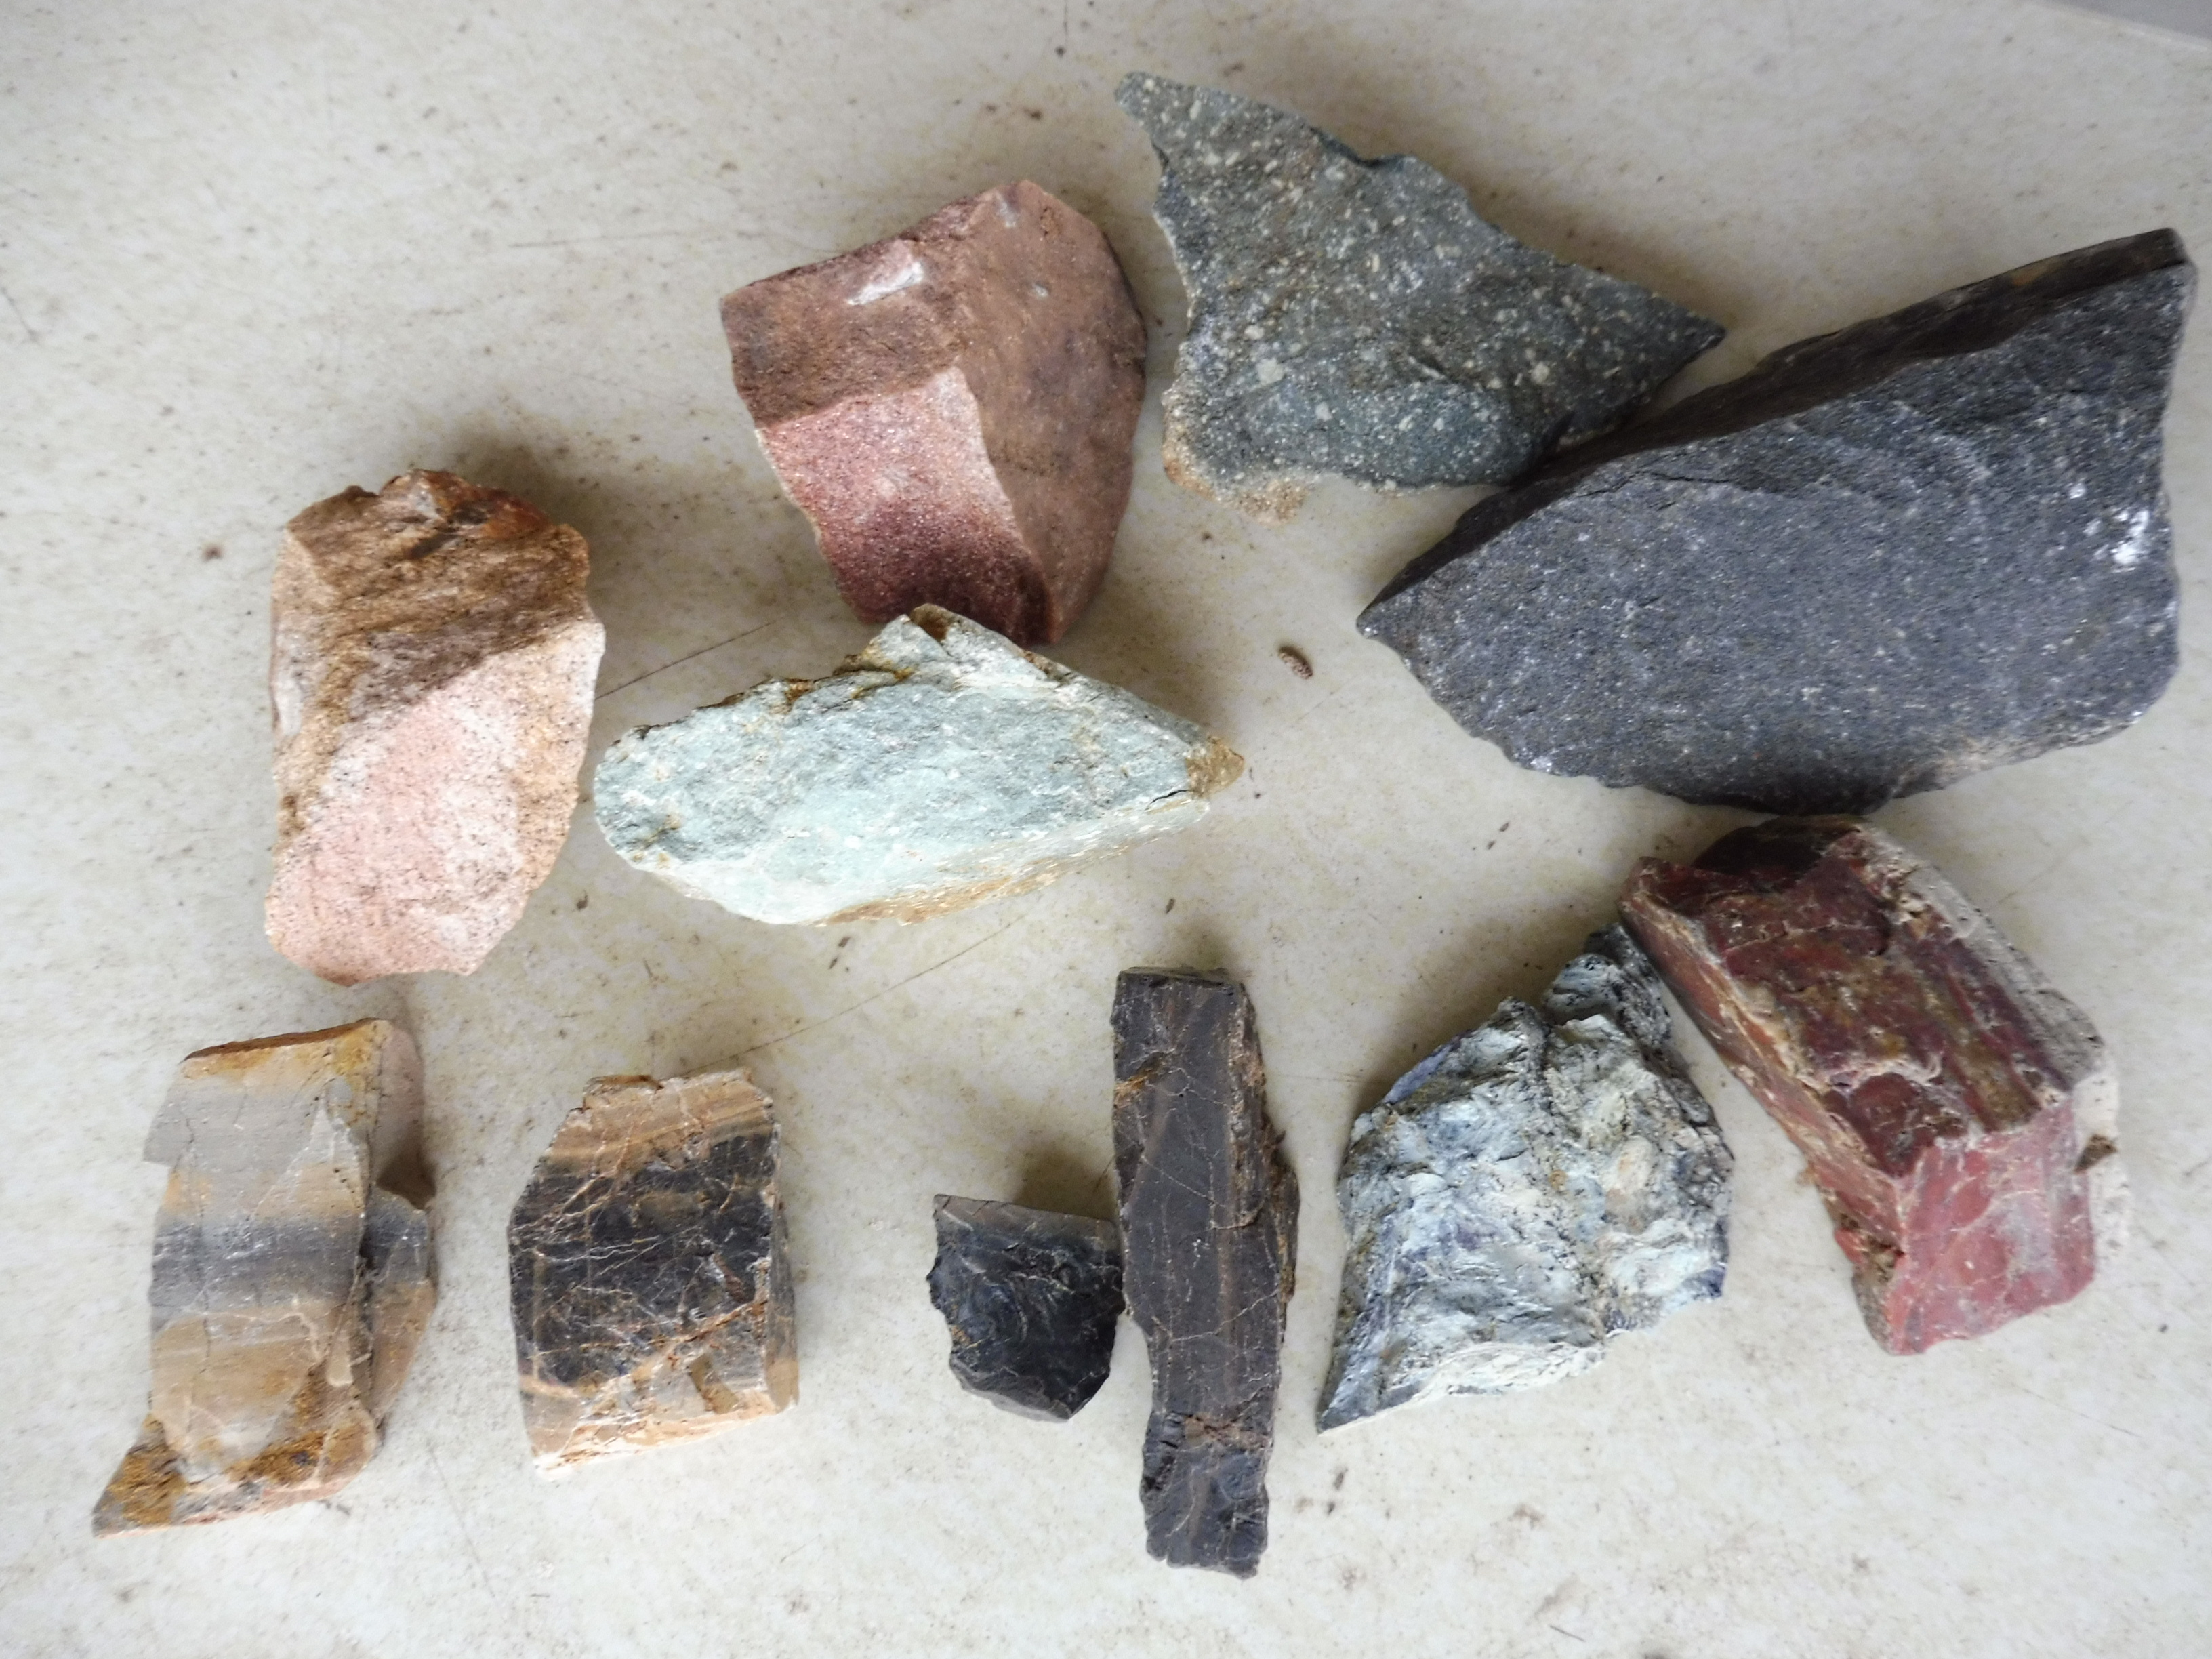
Cambrian rocks of Wickliffe
Among the oldest in Victoria. Include: Chert, greenstone, shale, Rhyolite

Slide 8
Other stuff
Visualizing Victoria’s groundwater
https://www.vvg.org.au/
https://resources.vic.gov.au/geology-exploration/victorias-geology
https://vro.agriculture.vic.gov.au/dpi/vro/coranregn.nsf/pages/cor_radiometrics_map

Slide 9
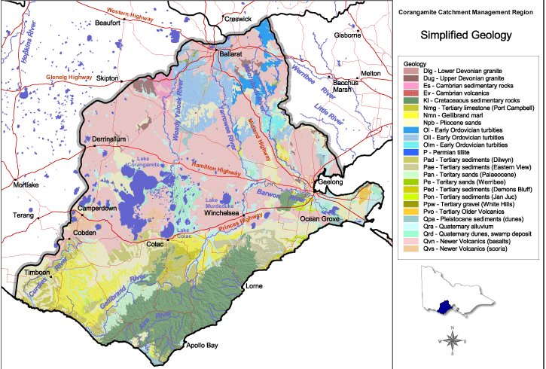
Geological map
https://vro.agriculture.vic.gov.au/dpi/vro/coranregn.nsf/pages/cor_simplified_geology

