Slide 1
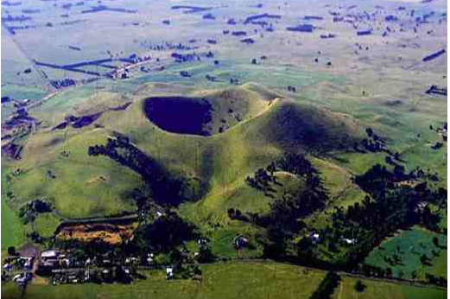
All about basalt
https://www.youtube.com/watch?v=ADN_GXgo3YY
The pale and glassy acid lava rhyolite/pumice is formed in subduction volcanoes. (PNG, White Island)
Bluestone/scoria/tuff is alkaline lava and formed
around here.(scoria cones,
crater lakes, stony rises)
Back to the history….

Slide 2
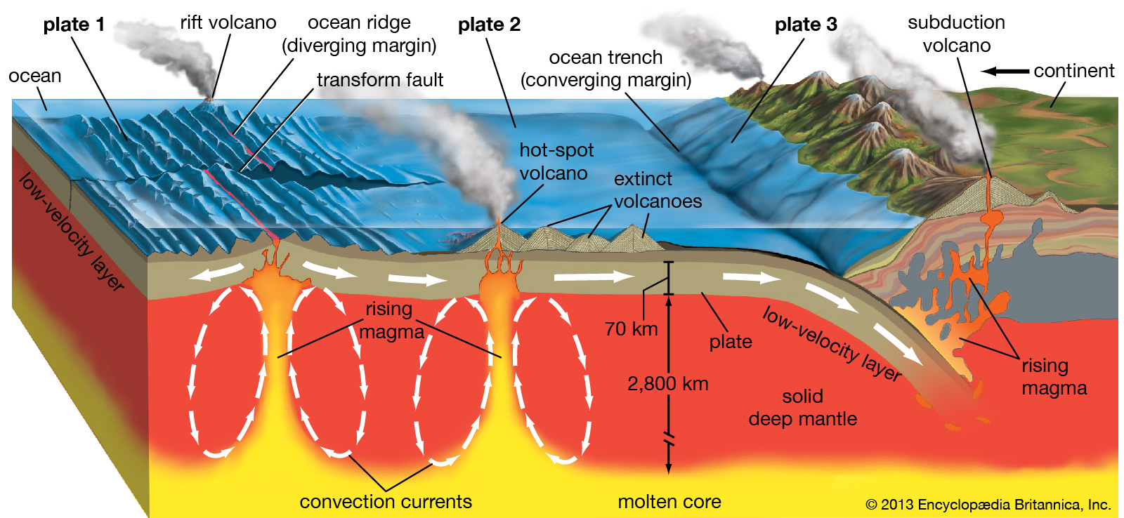
Volcanoes!! Rift/ Ridge/ Plate/ Subduction.
Ours are plate volcanoes.
Hot spot may be in the sea south of Portland?
Notes:
2

Slide 3
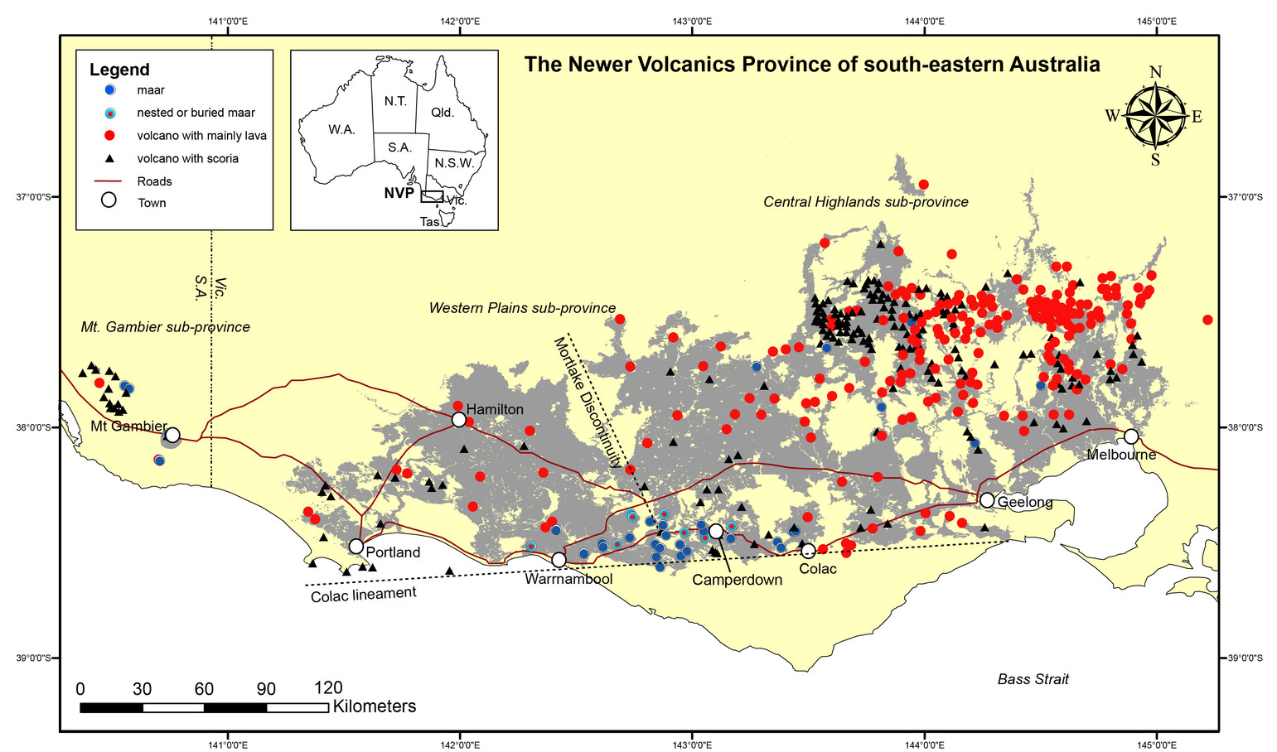
Basalt plains 1 to 6 mya
Notes:
3

Slide 4
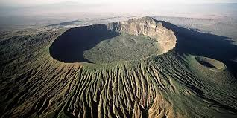
Shield volcano.
Mt Widderin (caves)
480000 years ago
All older lava flows
2-6 million years
No water. Bluestone.
Mt Gellibrand
Mt Hamilton, Streatham
Notes:
4

Slide 5
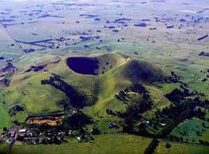
Scoria cone
Mount Noorat
Mount Elephant
Eruption through water forms scoria
Crater above water table in limestone.
Surrounded by stony rises lava flows.
Notes:
5

Slide 6
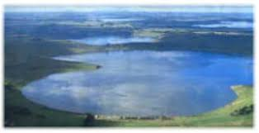
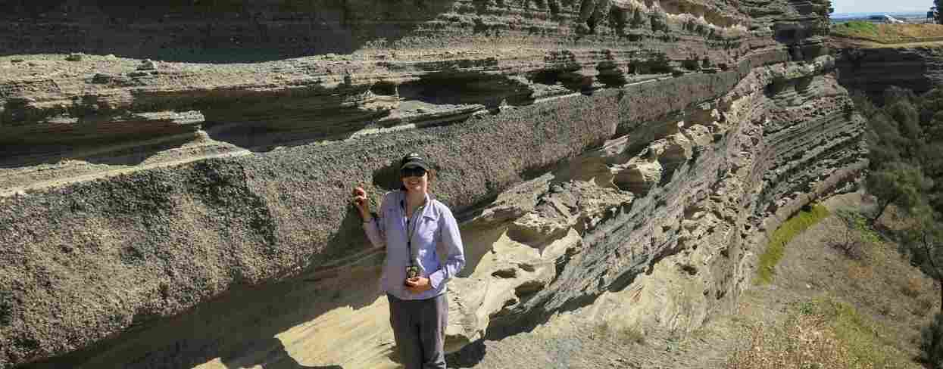
Maar, (crater lake)
BullenMerri, Gnotuk
Purrumbeet, Tower Hill
In Aboriginal times
Thick water table
Crater lakes.
Rock blown to dust
No stony rises.
Fertile soil
Notes:
6

Slide 7
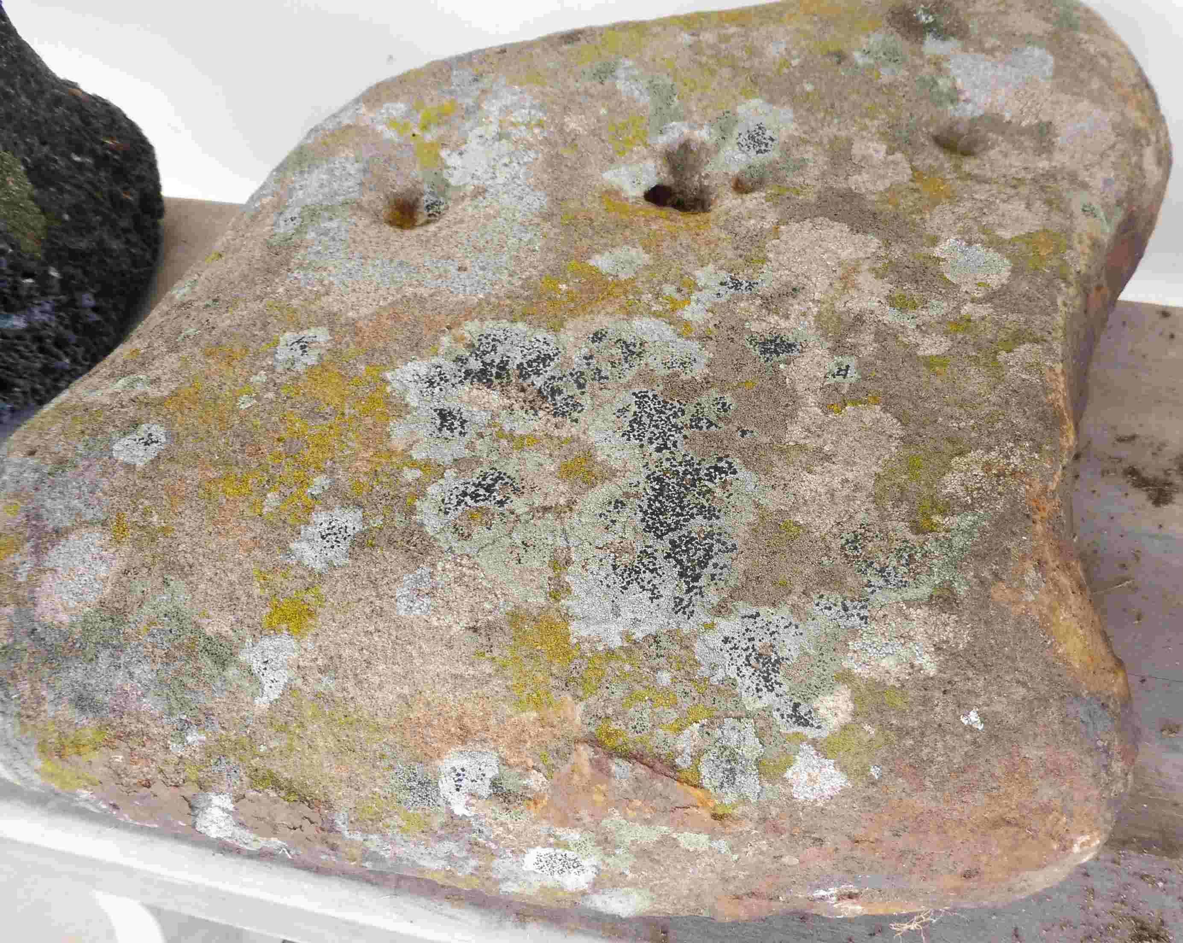
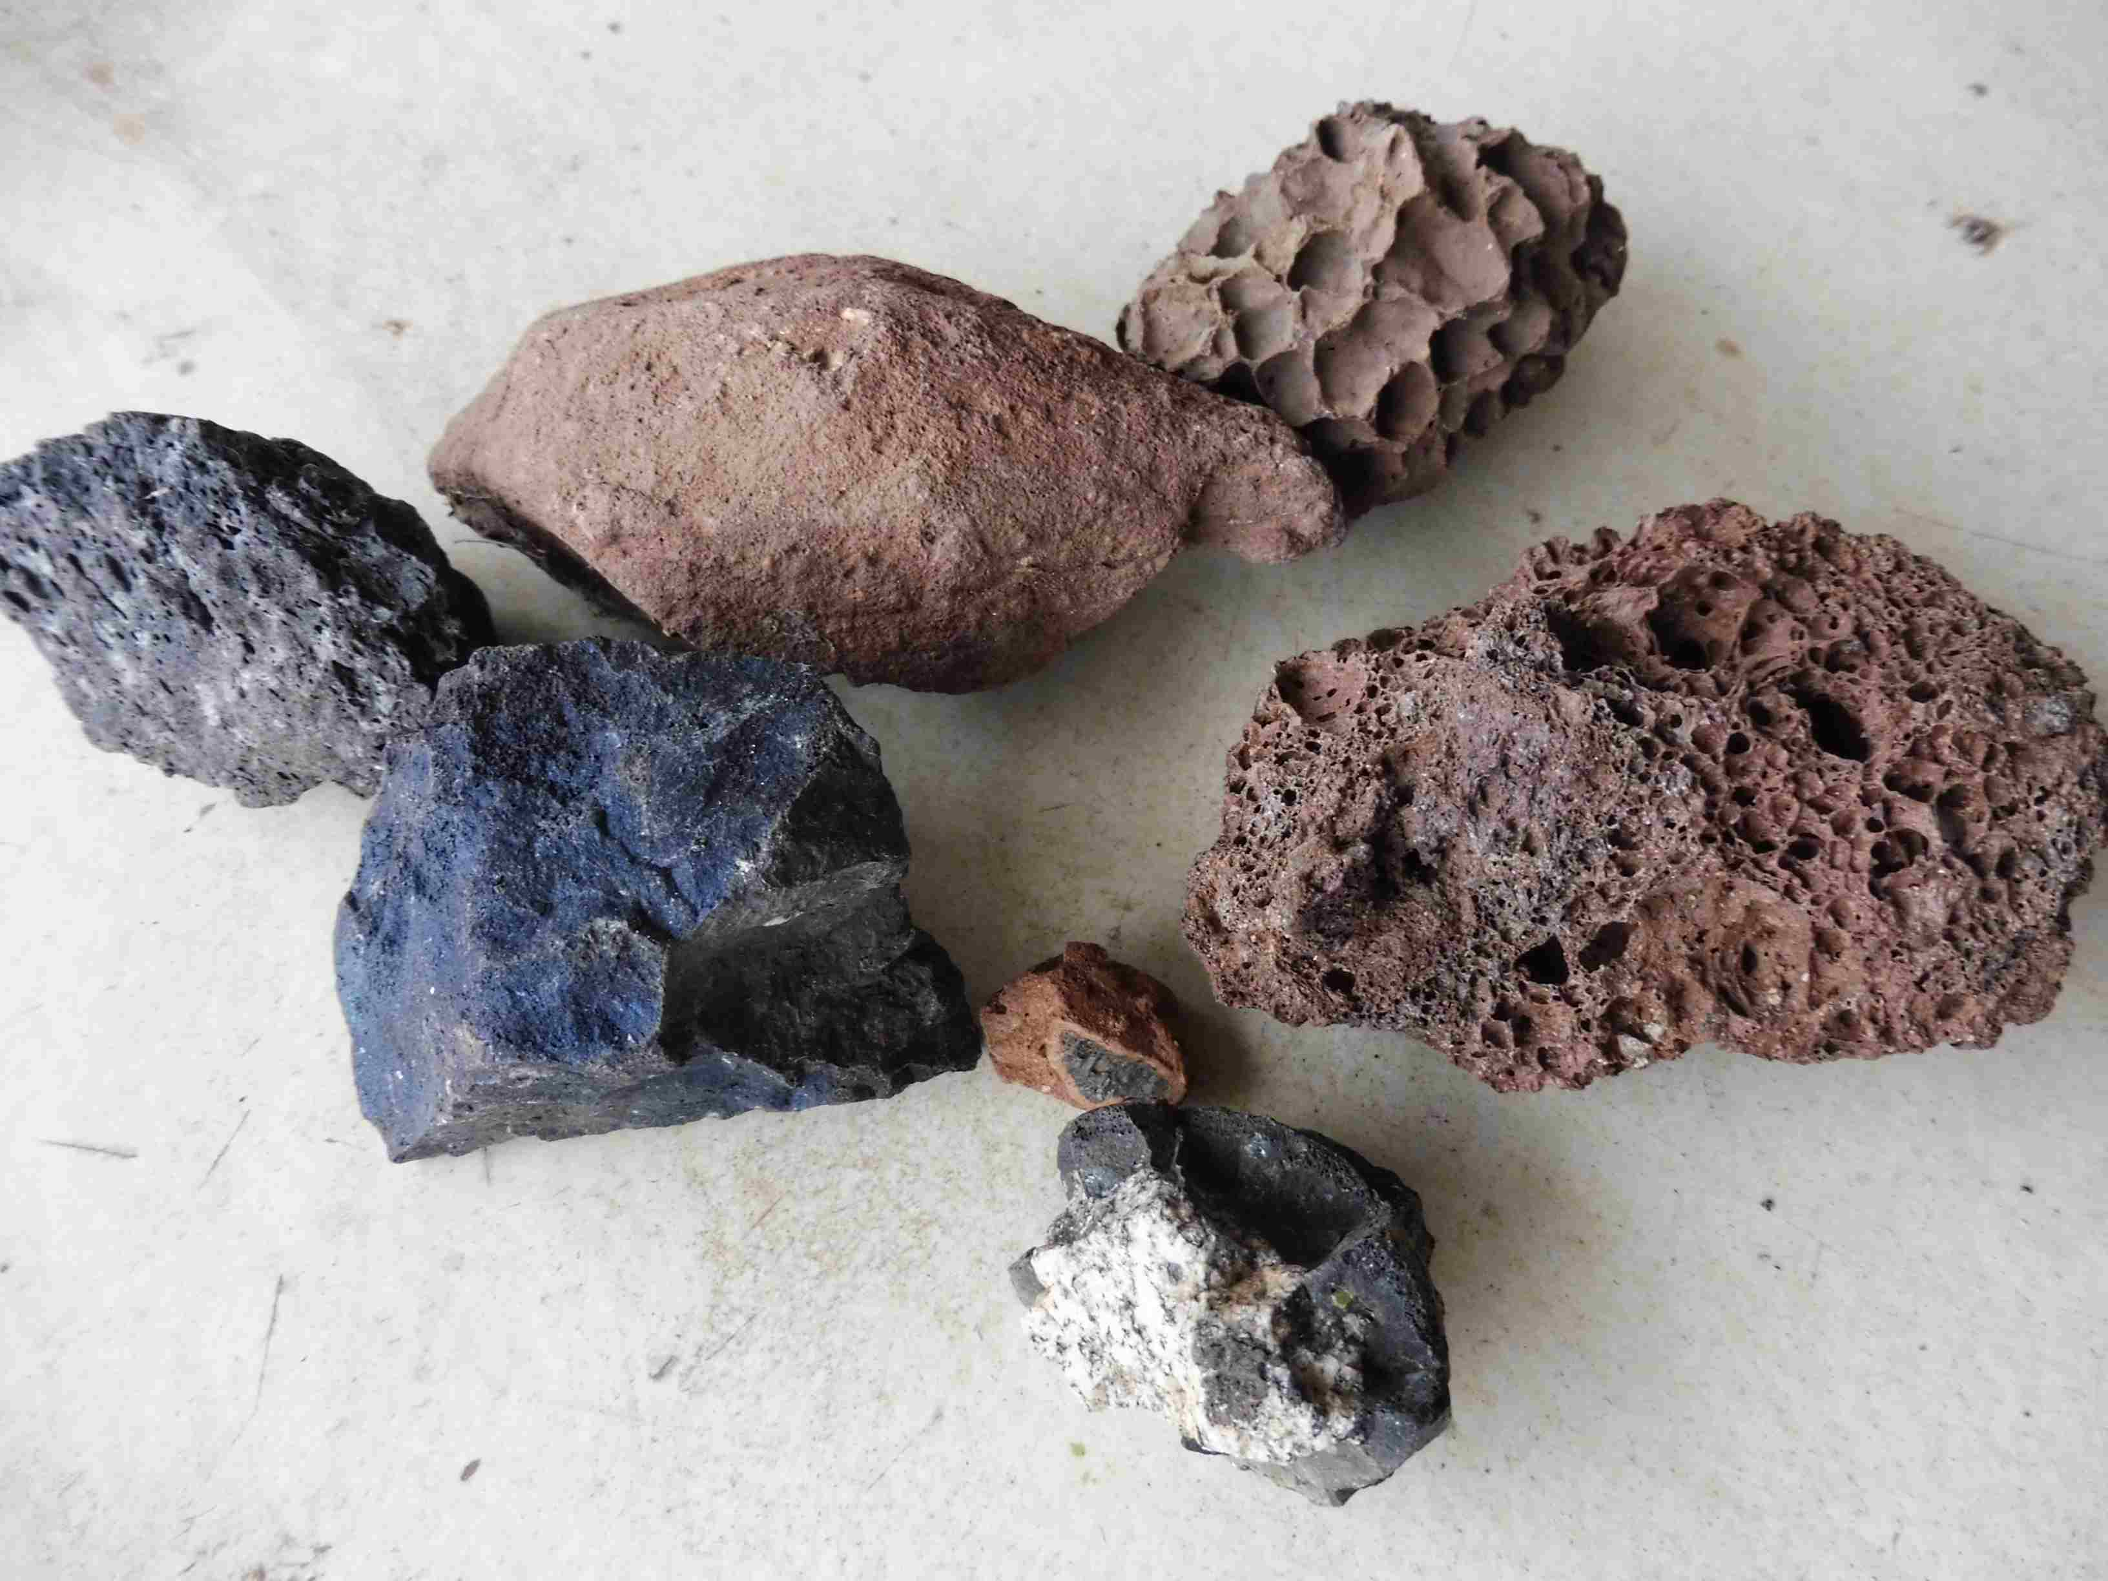
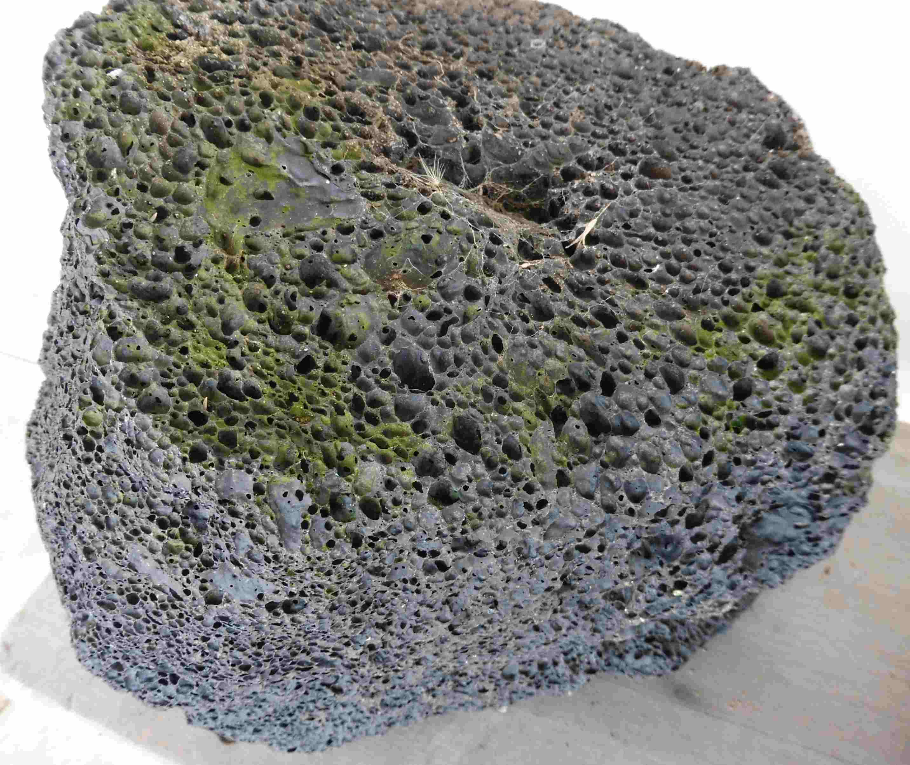
Volcanic rocks
1 mya
180kya types
180kya

Slide 8
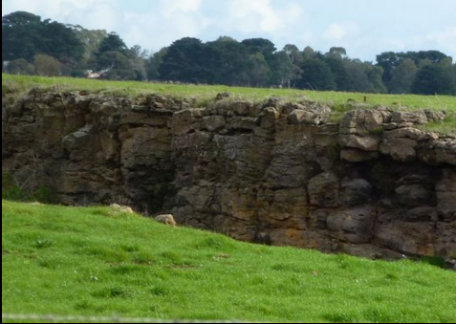
Basalt uses.
Bluestone for Buildings
Crushed for Rail ballast
….And road surfacing
Sawn as facing for city buildings
Quarries in recent lava flows give dense rock with few bubbles

Slide 9
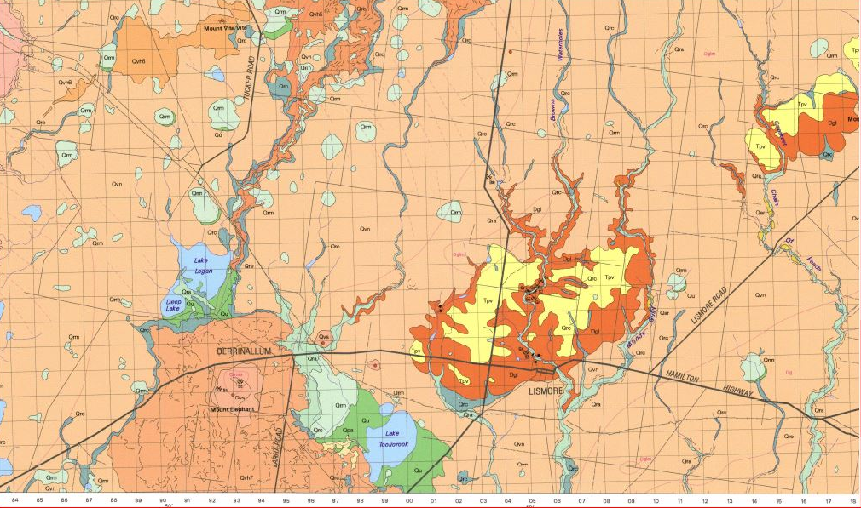
Lismore geology

Slide 10
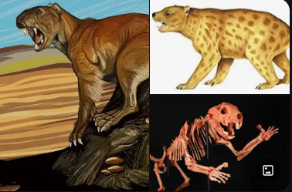
The megafauna
Lavaflows blocked creeks to form wetlands
This encouraged early birds and megafauna
Some left tracks and fossils.

Slide 11
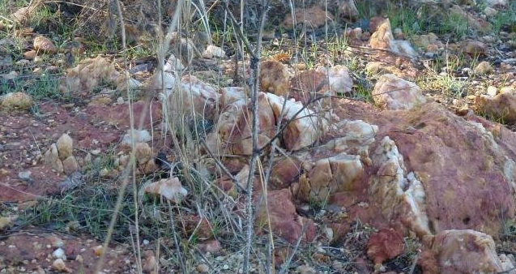
Mysteries 1.
Quartz reef in ironstone band on north shore Lake Tooliorook.

Slide 12
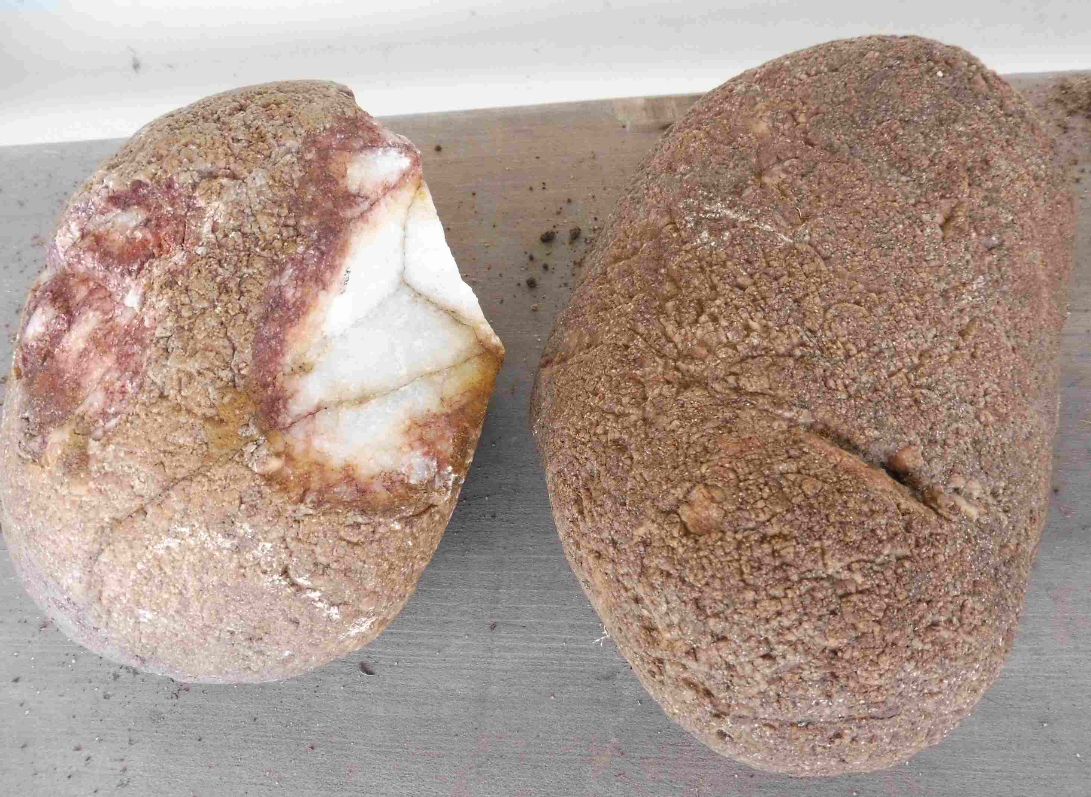
Mysteries 2
Contour line of smooth quartz stones on the “boomerang ridge”. Glacial origin?

