Slide 1
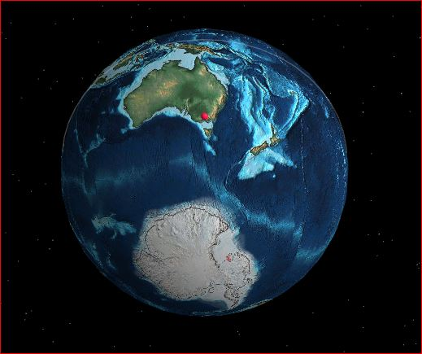
Geology of Lismore area
A brief, wet & bumpy trip down memory lane......
Geological SurveyVic. (references acknowledged)

Slide 2
Geology around Lismore
Meet the Earth!
We will look at some important dates
What happened in the past….
…..and what traces we see of it now.
First, we set up the earth as it is today.
(Must pay extra to see tomorrow!)
https://dinosaurpictures.org/ancient-earth#0
https://weekendgeology.com/geology-of-victoria-1/

Slide 3
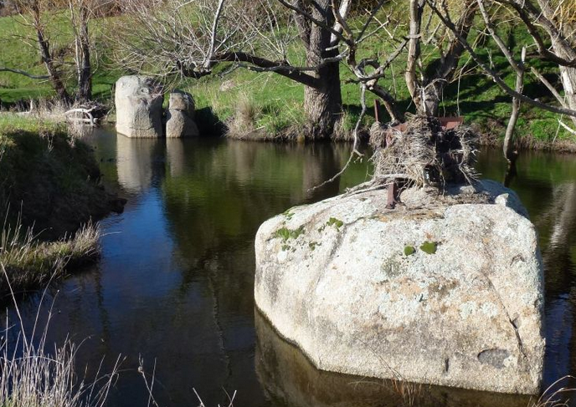
Meet the Earth But first: some basics……
How old?
How big?
What layers?
https://www.youtube.com/watch?v=98io3UItZ98
What is the crust made of?
B….., G……, L……..,
Then: S........., Min.…., Met…….

Slide 4
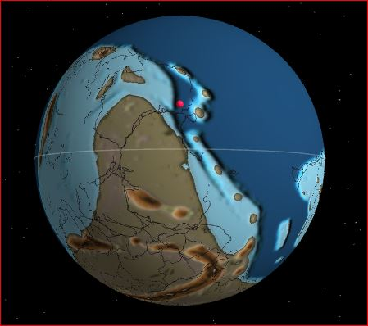
Cambrian 500 million years ago...
We are…..
Deep under the sea
Near New York
Crashing into Pangea (Gondwana)
Volcanoes nearby
“Cambrian explosion” of marine life

Slide 5
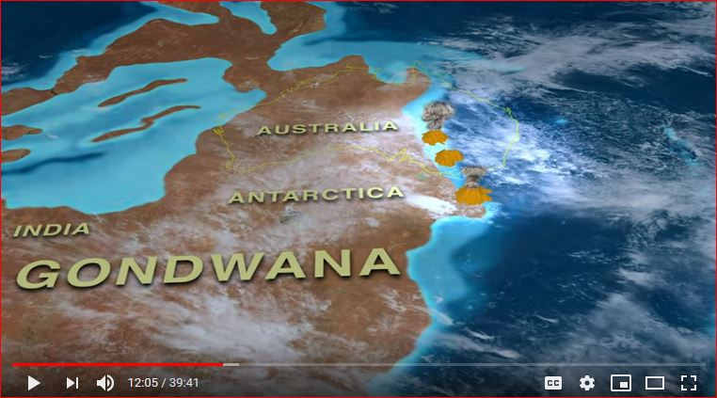
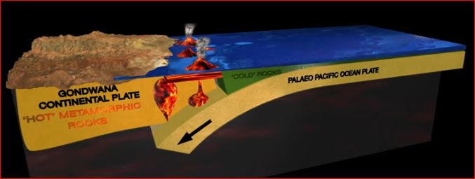
Gondwana subduction.

Slide 6
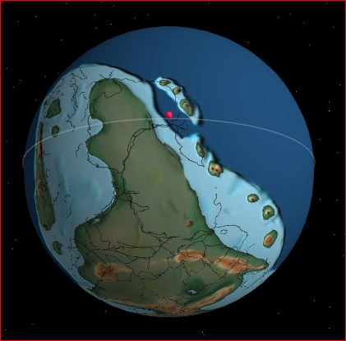
Silurian 450 mya
After a mass extinction
Deep under sea.
New animals shells.
Ballarat sediments/gold
Grampians strata
Drifting south

Slide 7
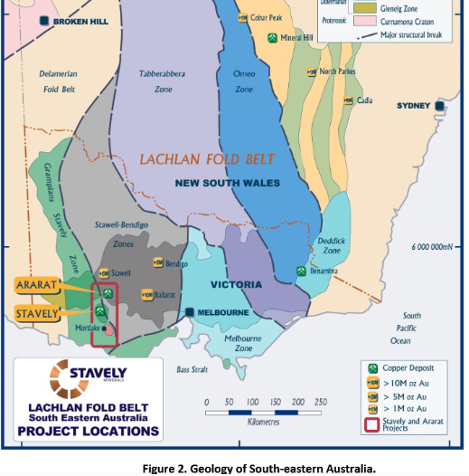
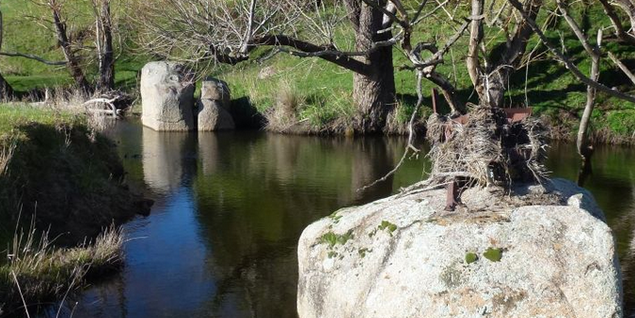
Traces of the time
Ballarat gold fields
Glenthompson hopes
Lismore Granite

Slide 8
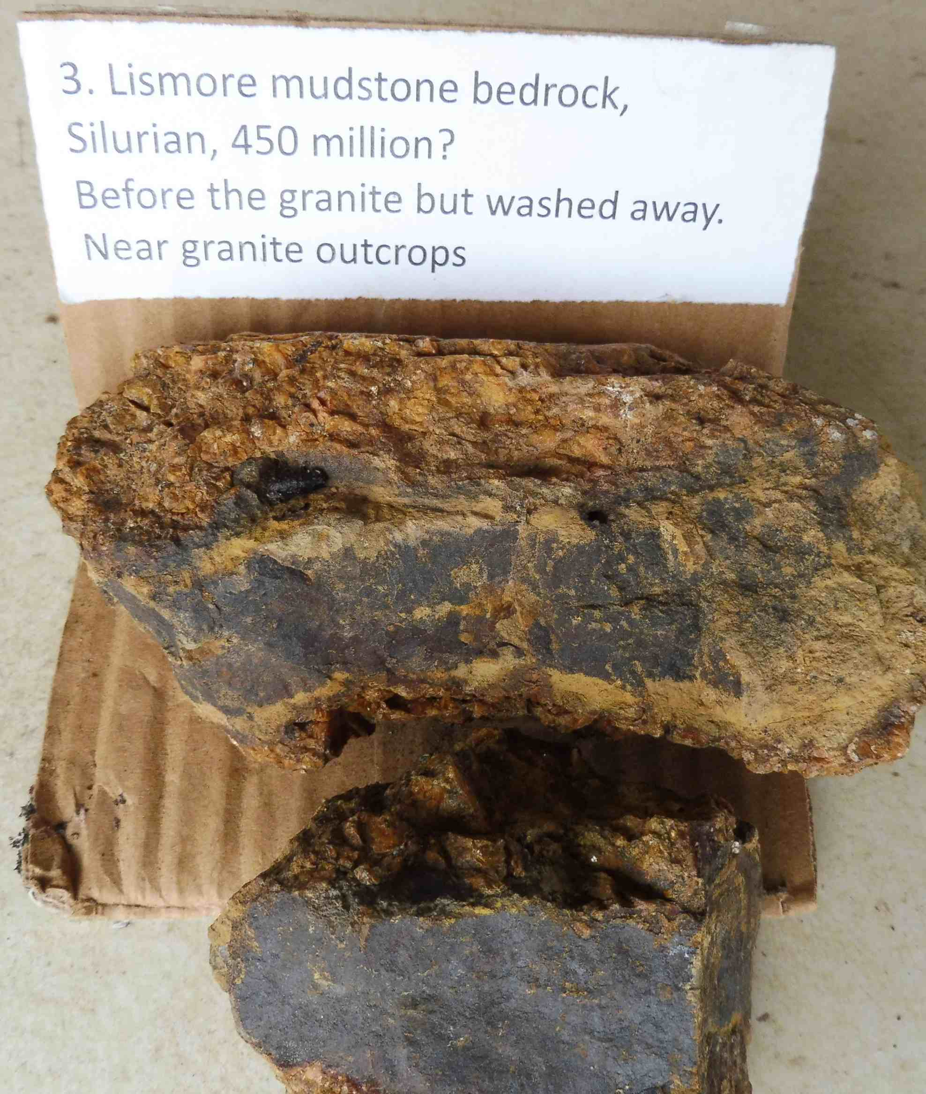
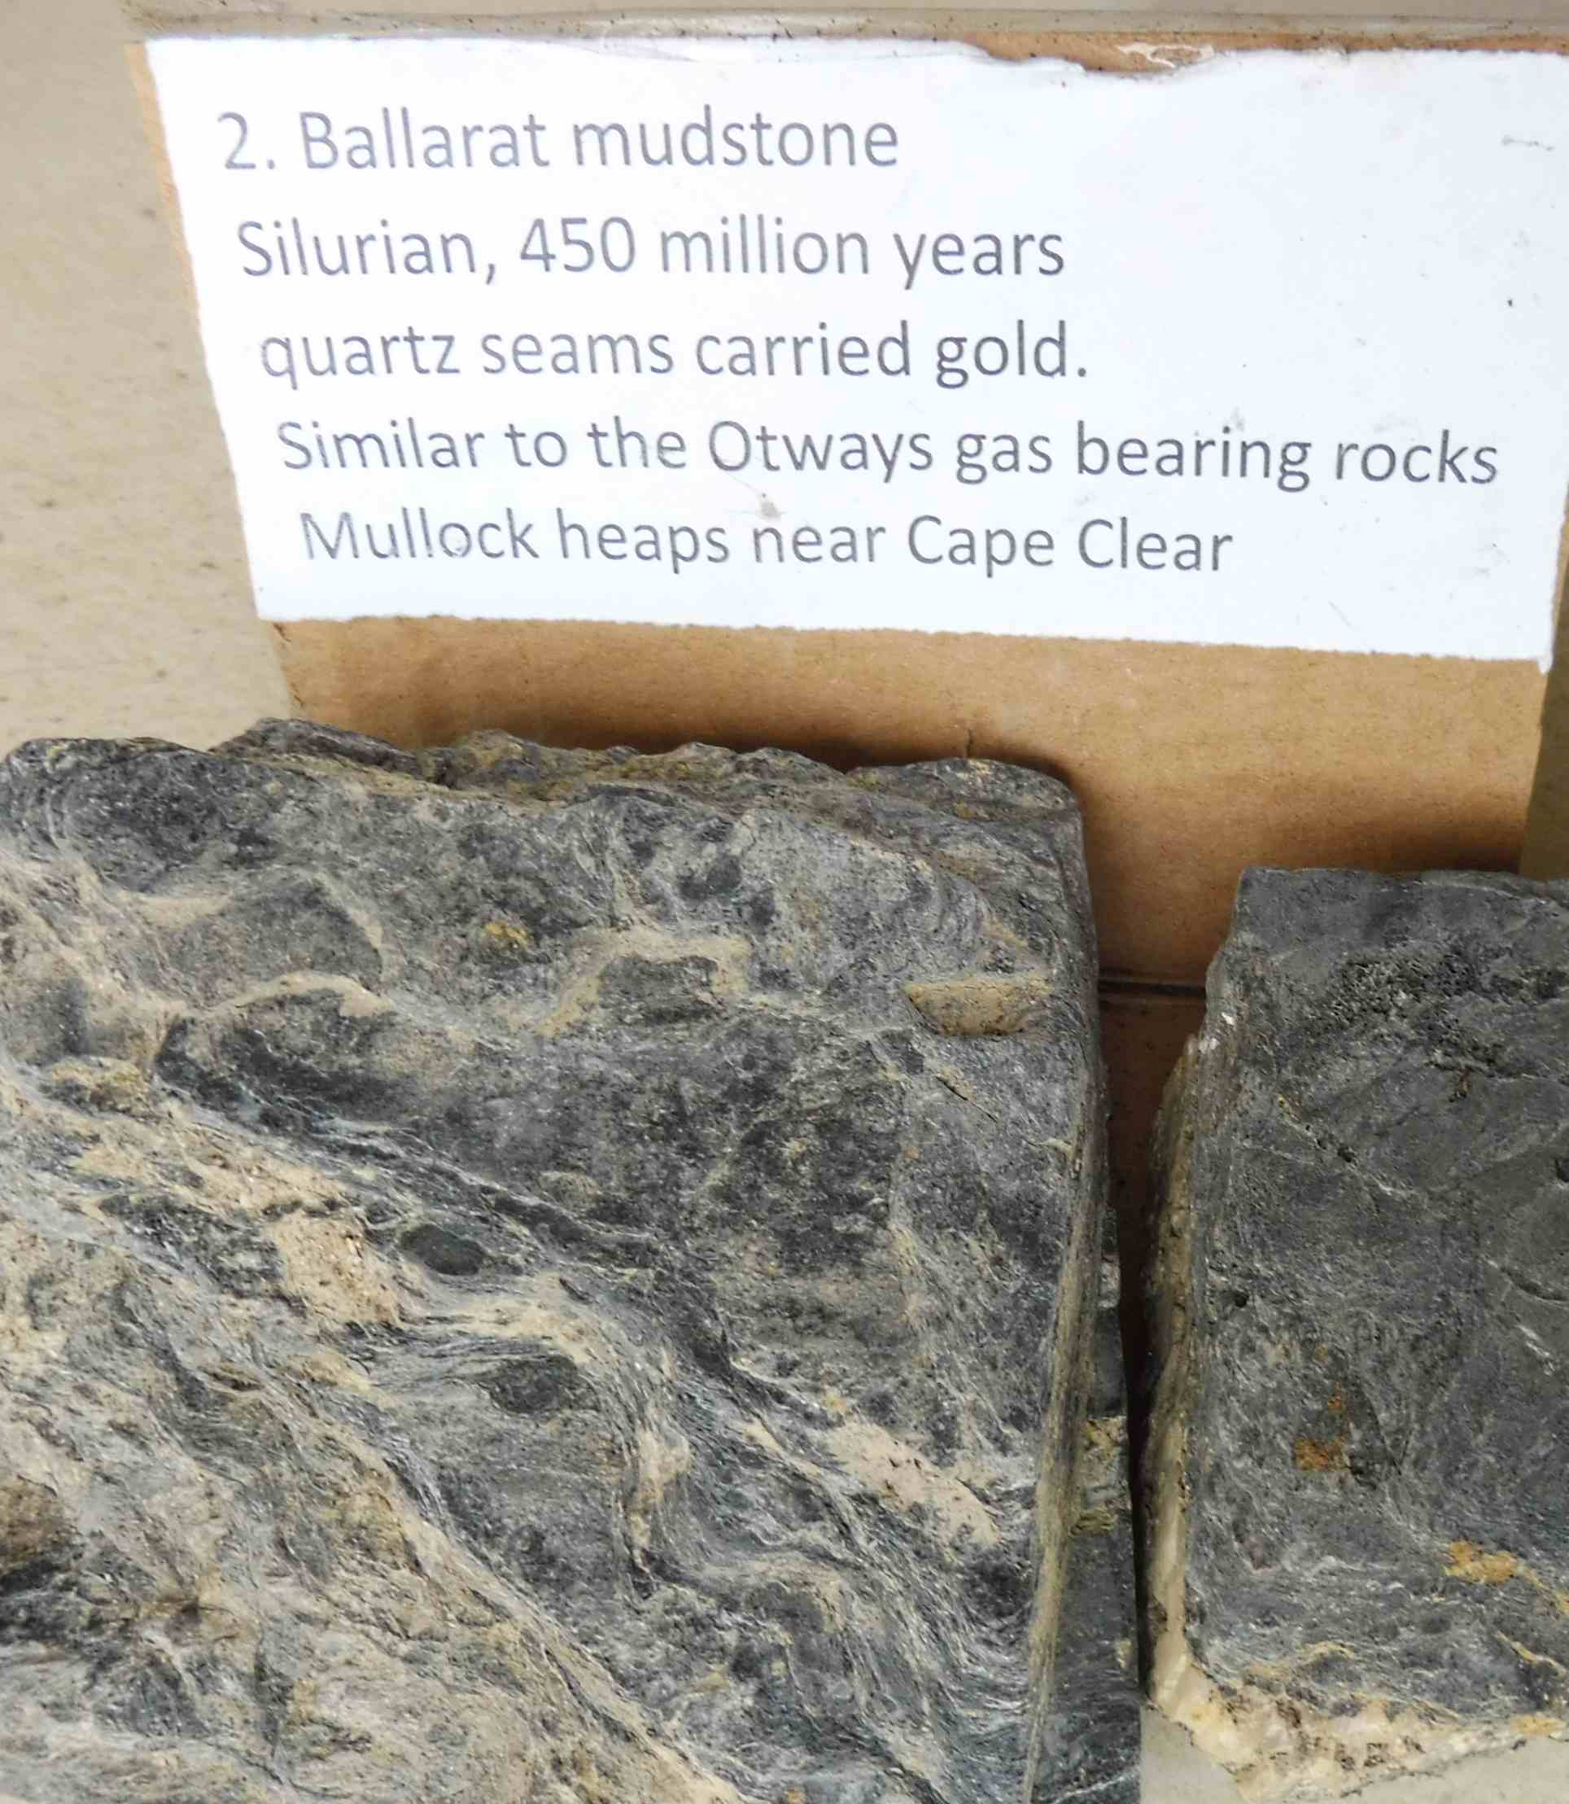
Our oldest rocks
Gala sandstones
Silurian? 430mya
Ballarat mudstones
Ordovician 450mya

Slide 9
Devonian 400 mya
Grampians deform
Fish with skeletons
Plants, land animals, insects
Gold and copper intruded into Ballarat and Stavely
Still under water
Near Kenya
Under the sea bed
Granite melted up to us near Lismore

Slide 10
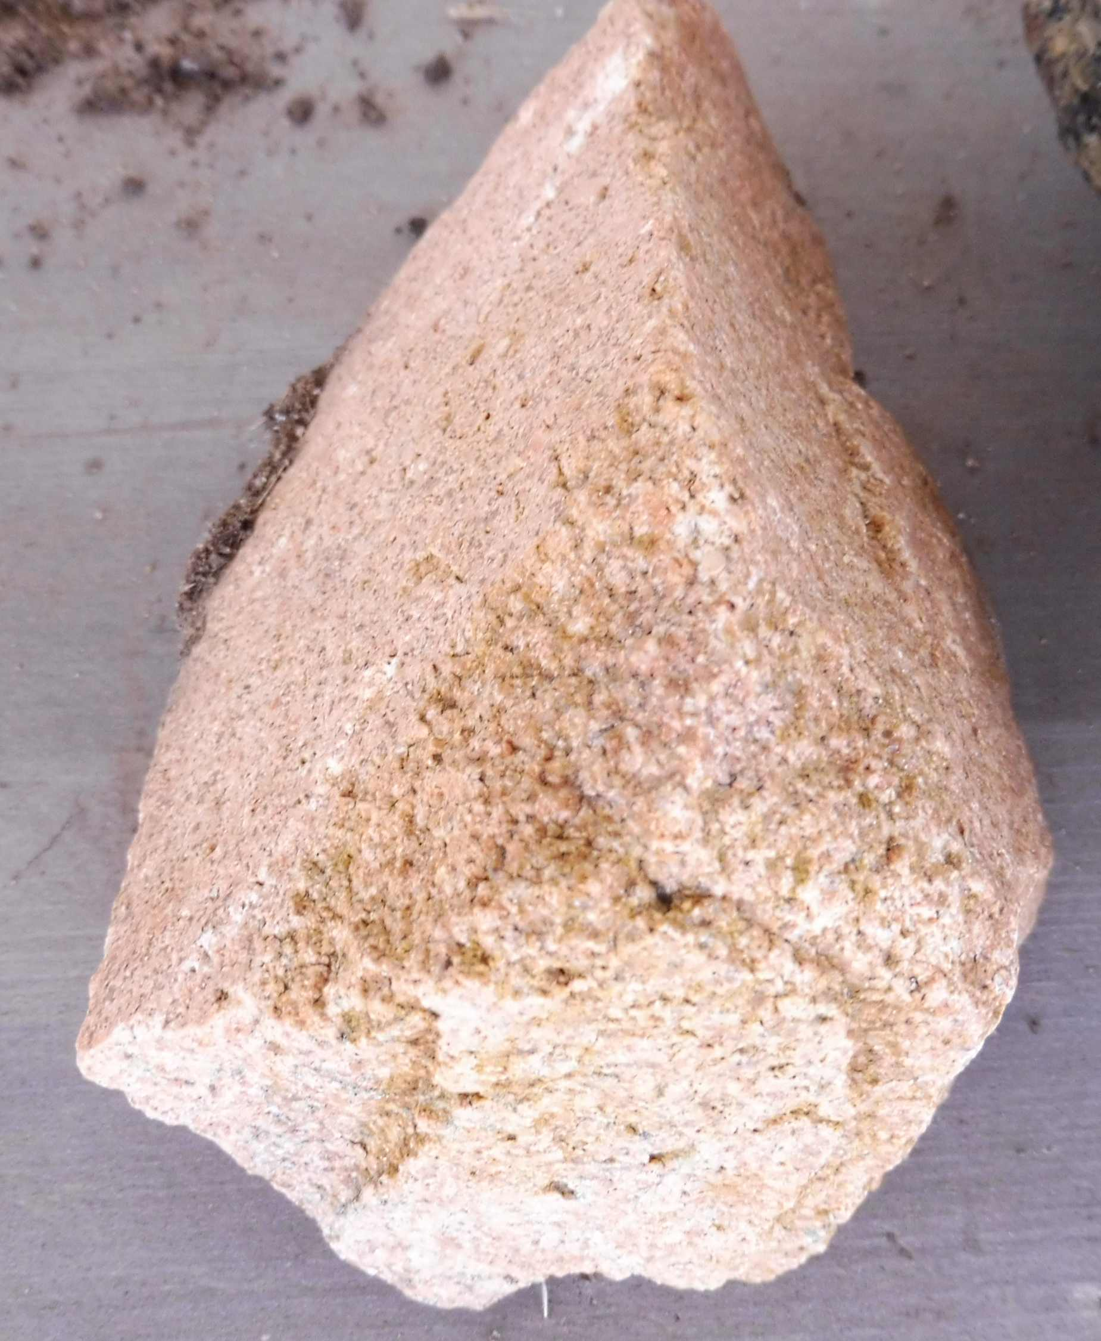
Granite and quartz intrusions
Gala again…to Stawell
400mya. All colours

Slide 11
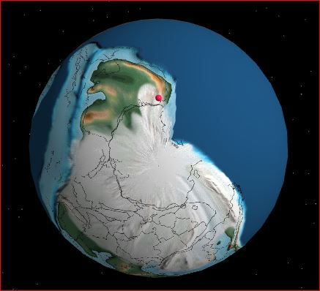
Carboniferous 300 mya
Now near the south pole
Above sea but under earth and ice.
And under melting glaciers
Trees rotting to form coal at Anglesea
Oil/gas forms under the sea
Coal forms in fresh water.
Fossils form in either?

