Slide 1
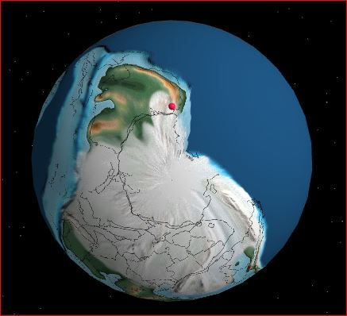
Carboniferous 300 mya
Now near the south pole
Above sea level but under earth and melting glaciers
Trees rotting to form coal at Anglesea in shallow lakes.
Oil/gas forms under the sea
Coal forms in fresh water.
Fossils form in both fresh and salt water?
Note the eroding mountain ranges
Notes:
1

Slide 2
Carboniferous 300 mya
Now near the south pole
Above sea level but under earth and melting glaciers
Trees rotting to form coal at Anglesea in shallow lakes.
Oil/gas forms under the sea
Coal forms in fresh water.
Fossils form in both fresh and salt water?
Note the eroding mountain ranges
Notes:
2

Slide 3
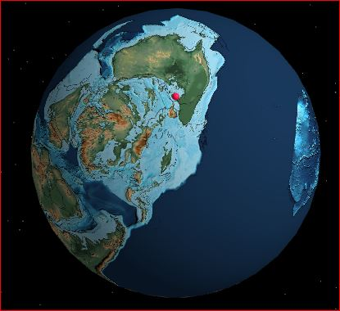
Cretaceous 145-66 mya
Drifting north
Under water again
Sea level rise from melting ice caps
Eroding mountains
Large reptiles
Small mammals
Flowering plants
Otways, oil, gas
And………
Notes:
3

Slide 4
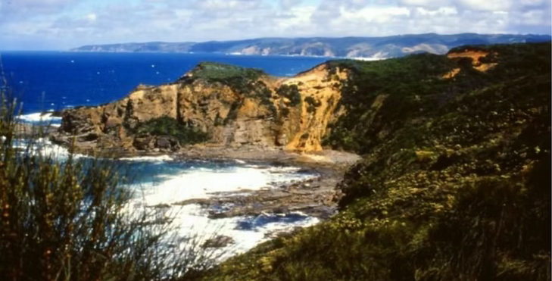
………Dinosaurs!
https://www.dinosaurdreaming.net/otways-sites/
While in the Antarctic. Many kinds. Many sites
Then extinction at 66mya. By a meteorite!
Dinosaur cove

Slide 5
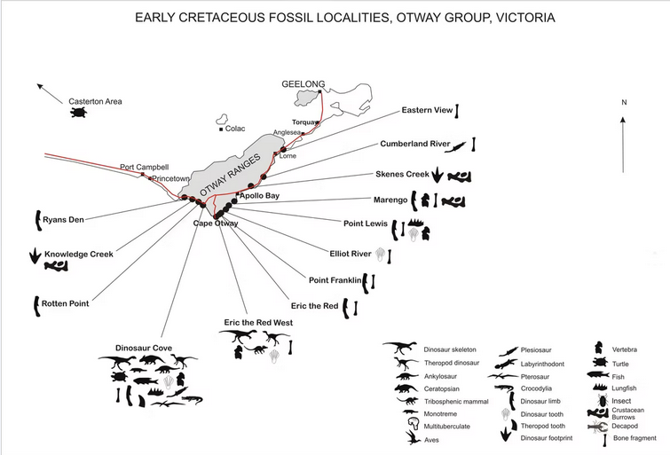
Fossil dig sites
https://www.dinosaurdreaming.net/maps-taxa?pgid=lr05dsss-3fb1bfde-0923-4f91-a9f8-65a2024e0a30

Slide 6
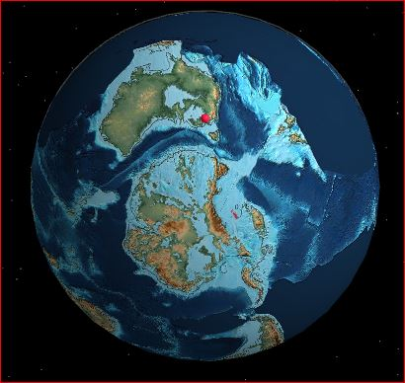
Tertiary 50 mya
After meteor impact kills dinosaurs
Areas under water as glaciers melted.
Otways forming from the mountain ranges
Sea shore at Lismore
Limestone layer from sea shells
Fossil teeth in Lake Keilambete
Notes:
6

Slide 7
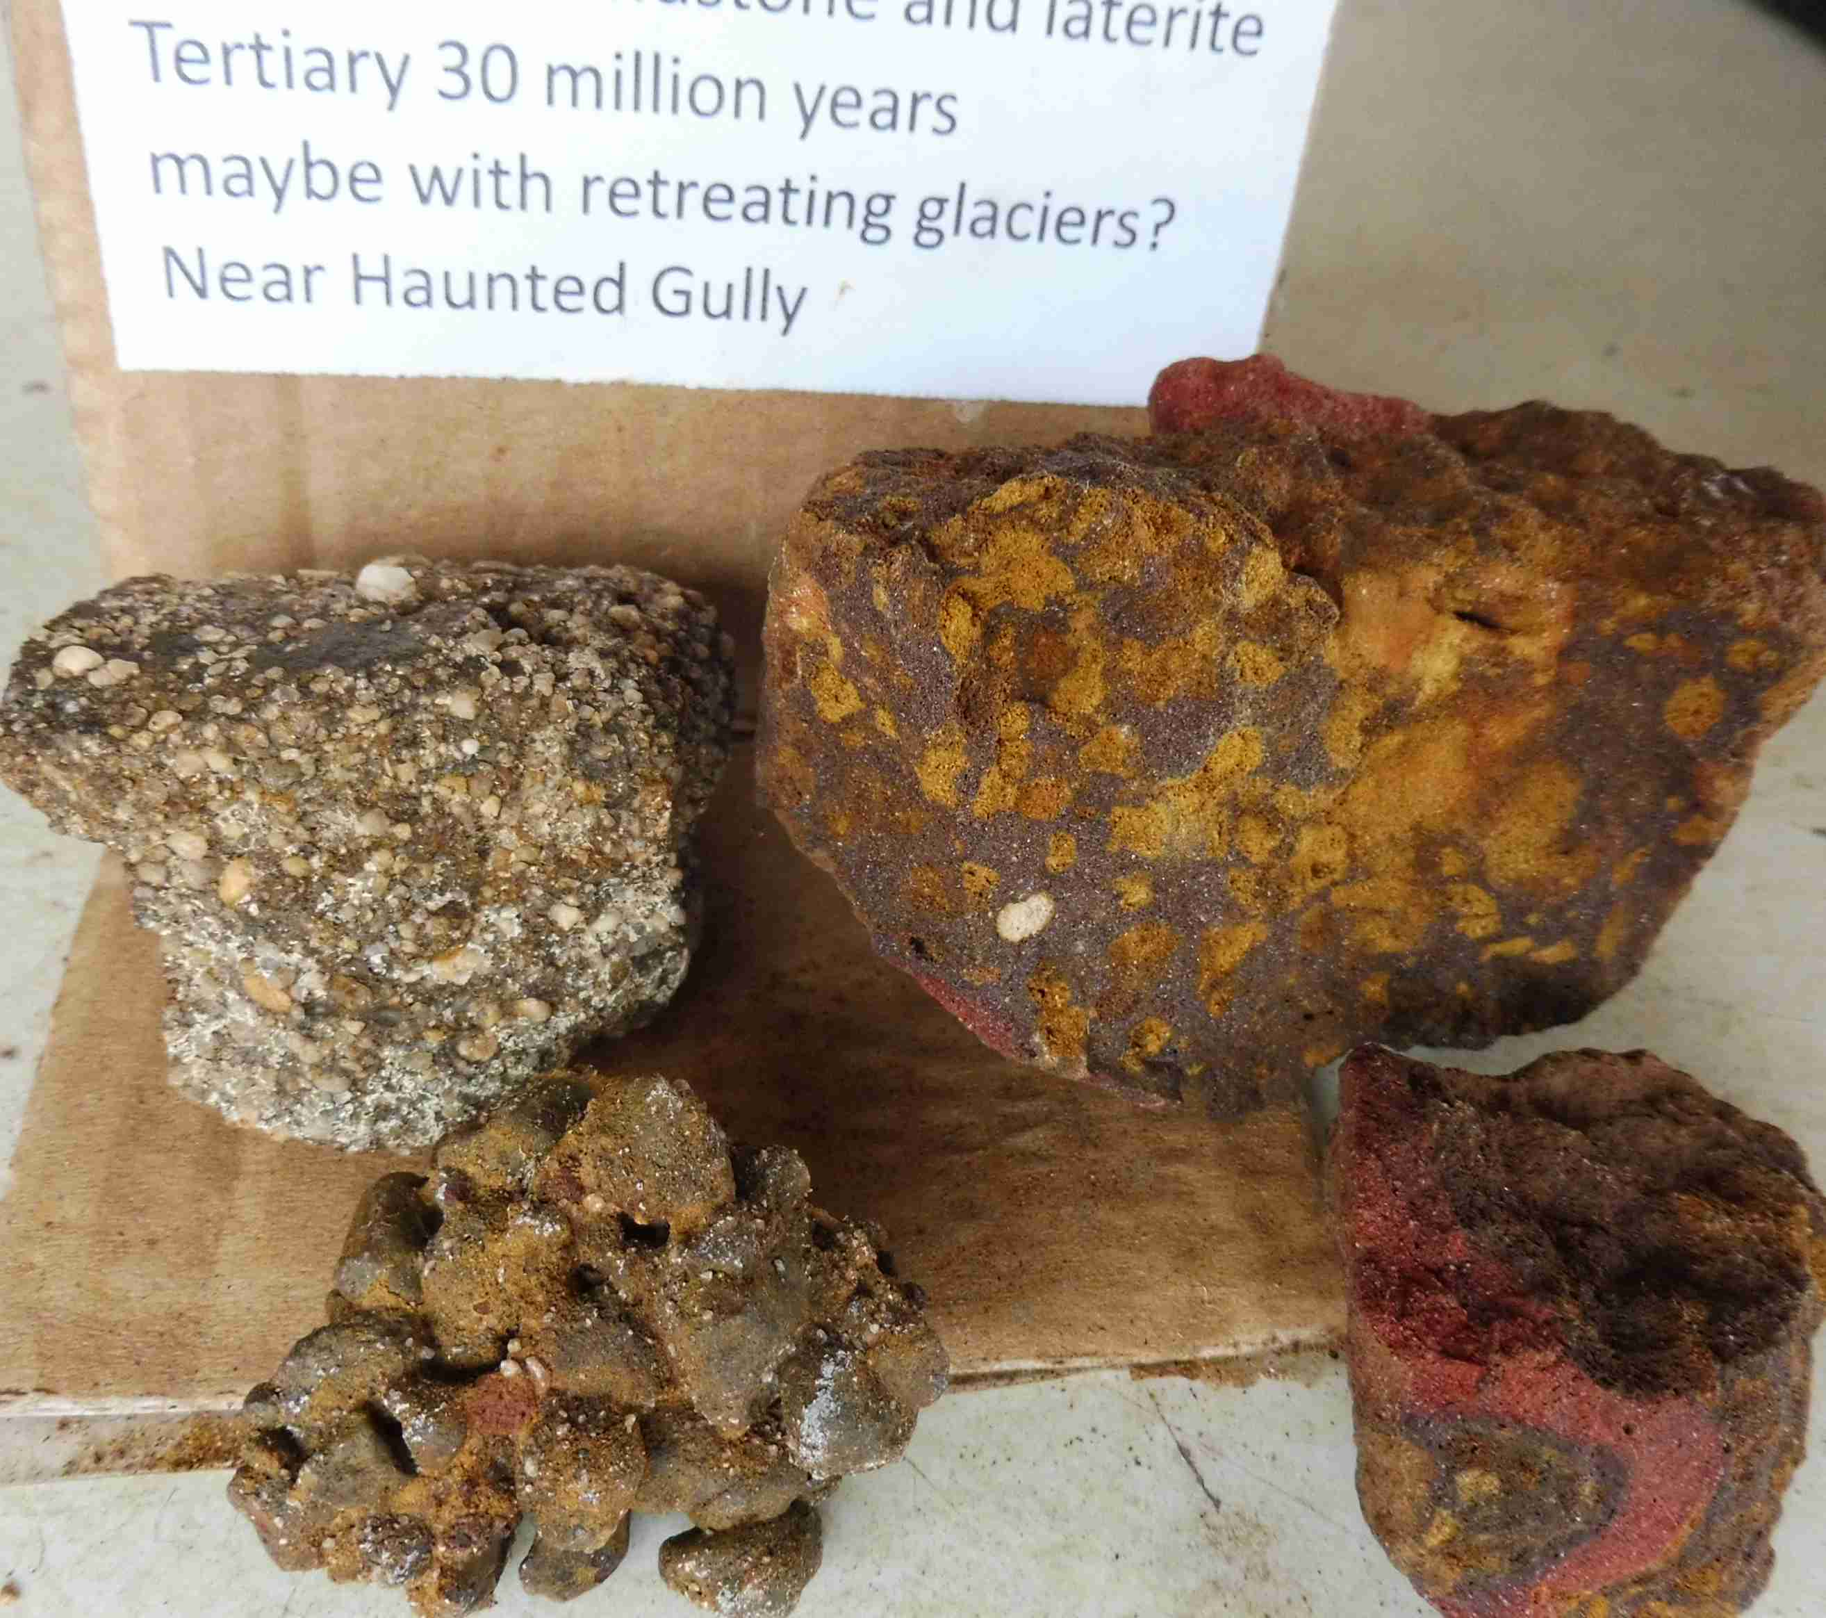
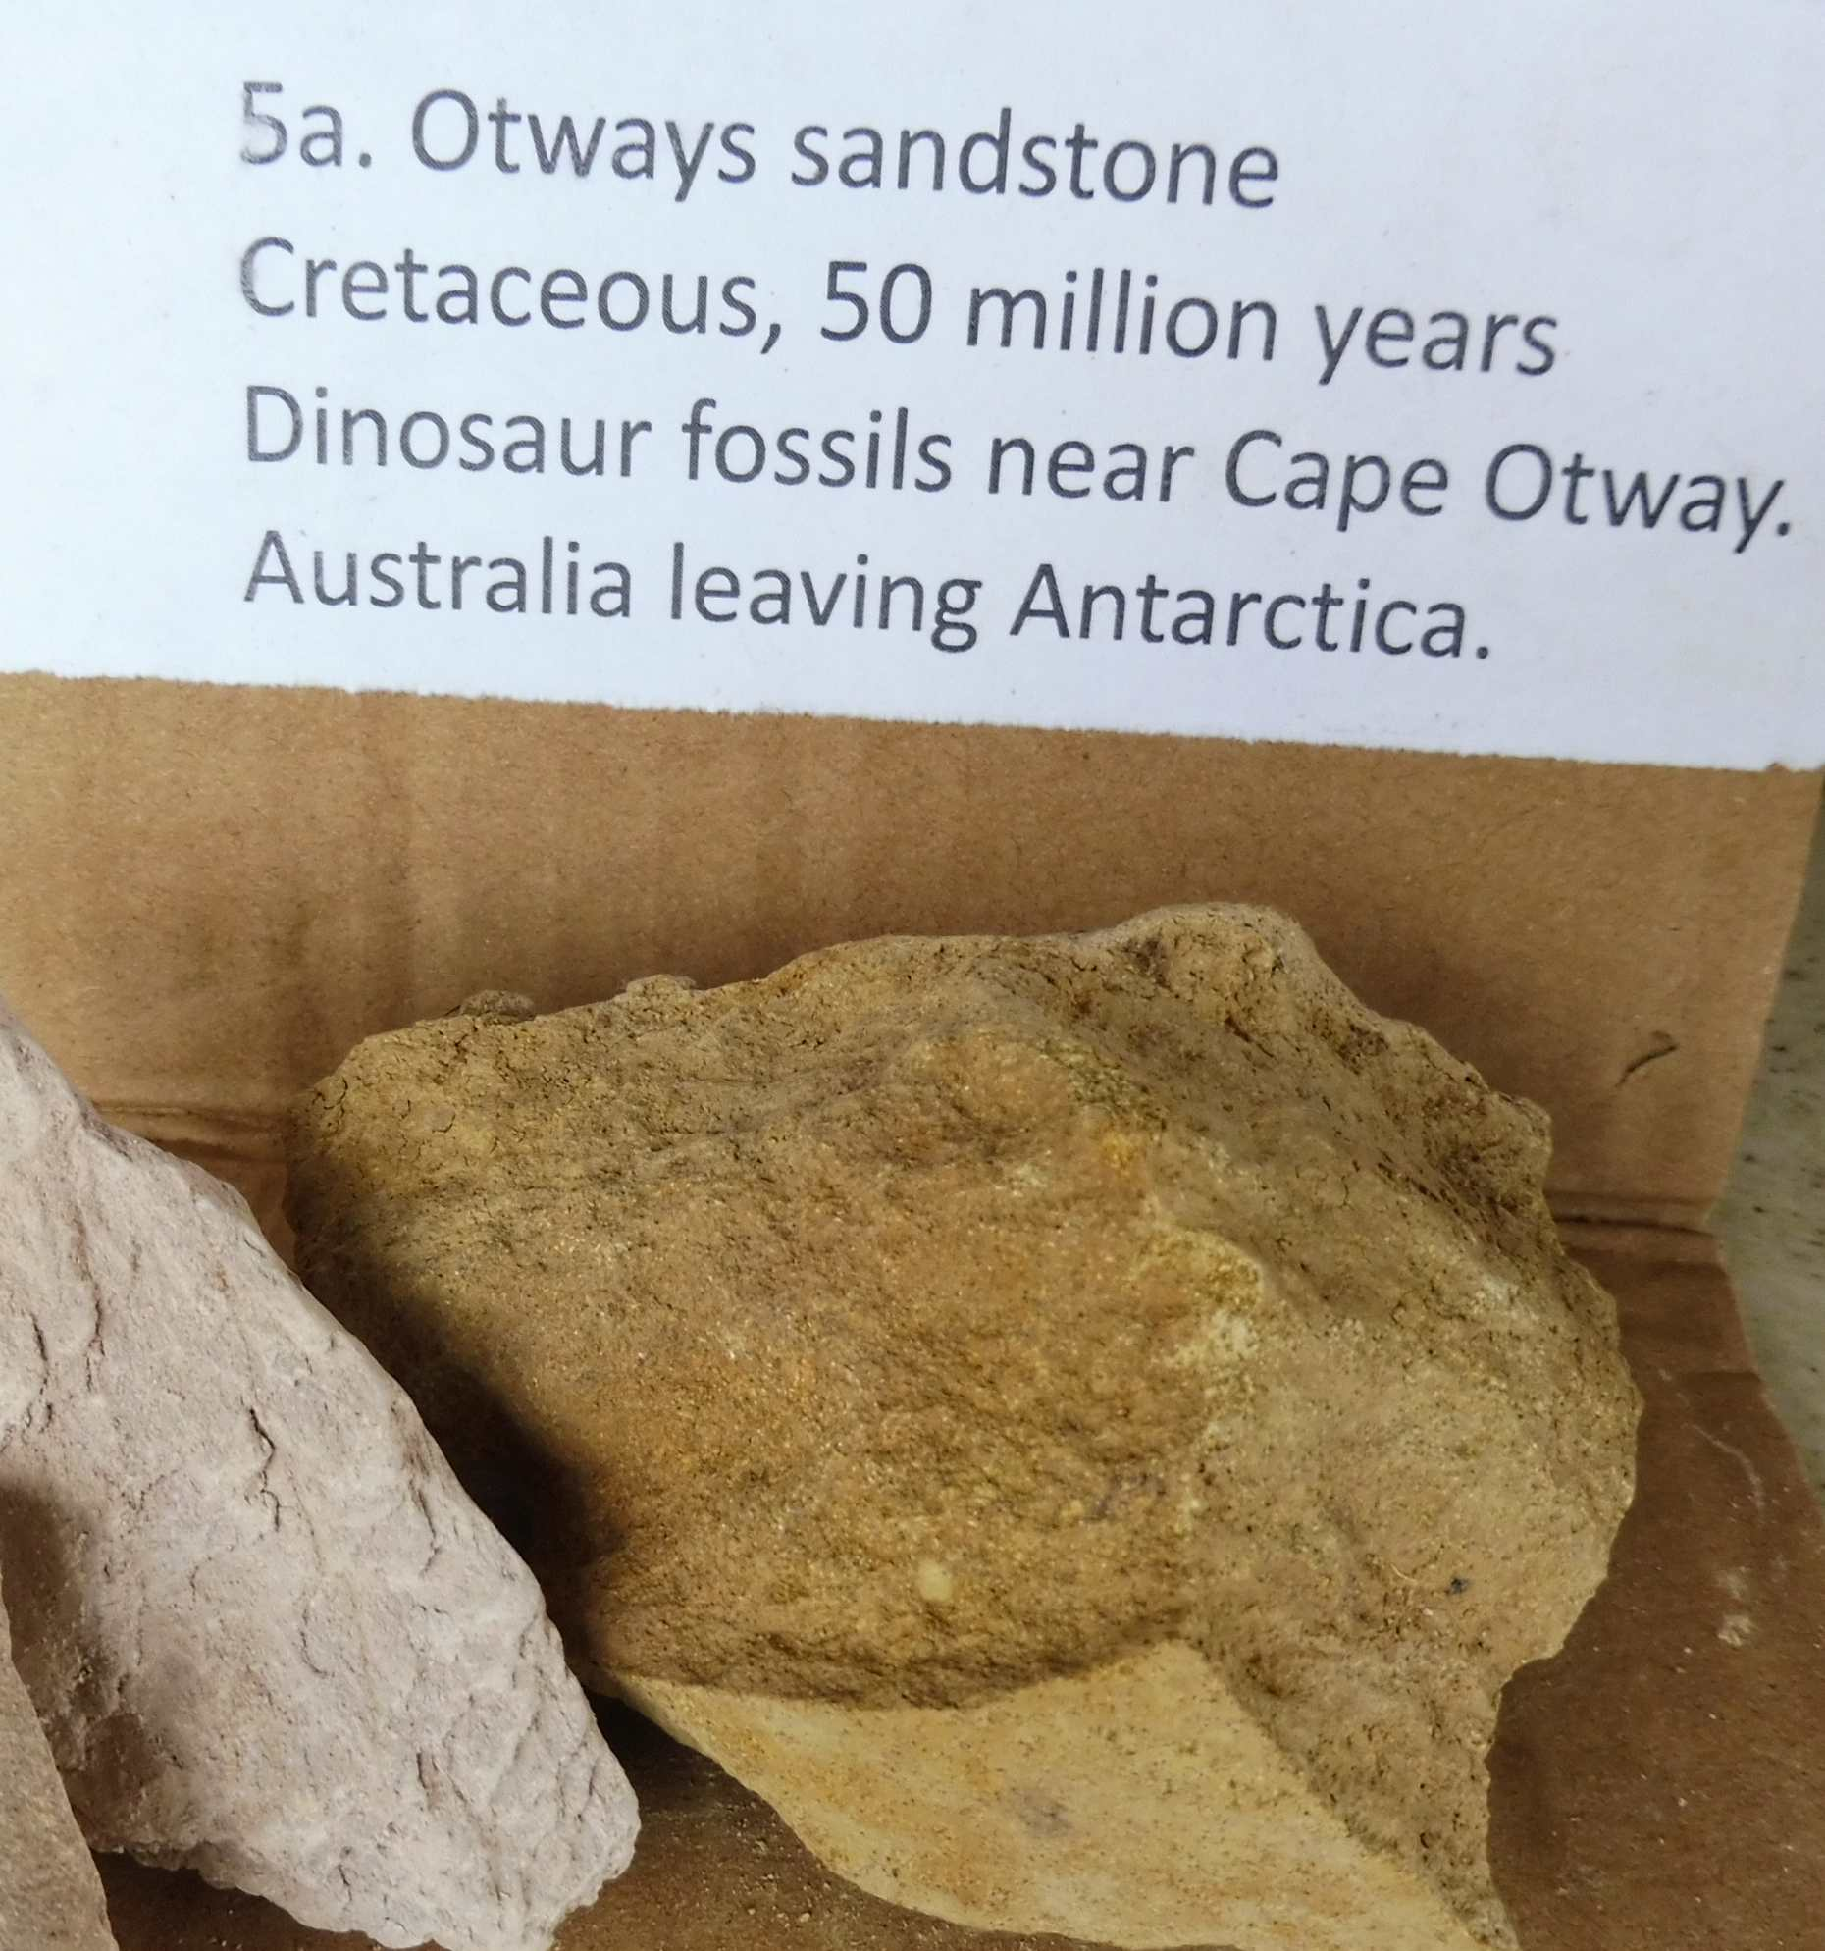
Ancient volcanic & granite ranges washed to sea
A range of sands and silts

Slide 8
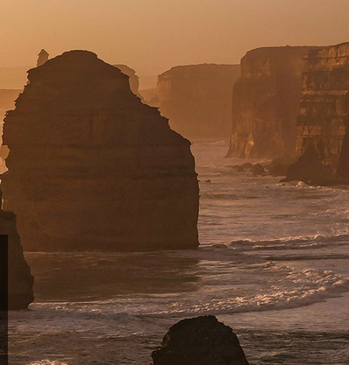
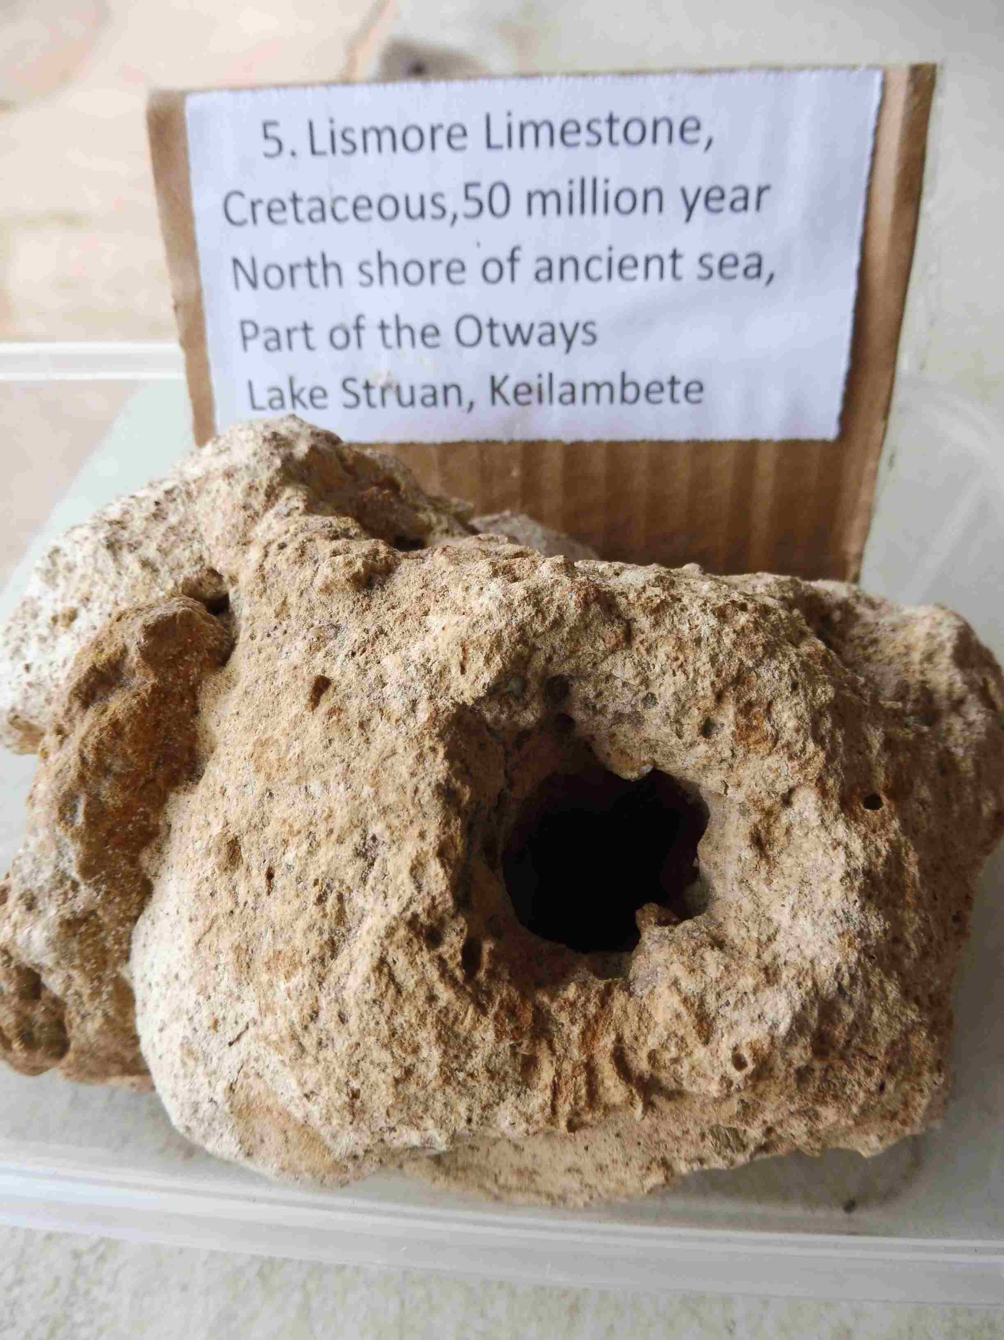
Then sea creatures formed limestone Our town water comes mainly from limestone flowing into the Gellibrand.
Limestone Coast
Some inland Struan dam.

Slide 9
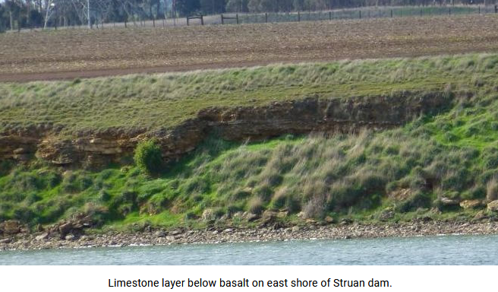
Our northern shoreline? Struan dam!

Slide 10
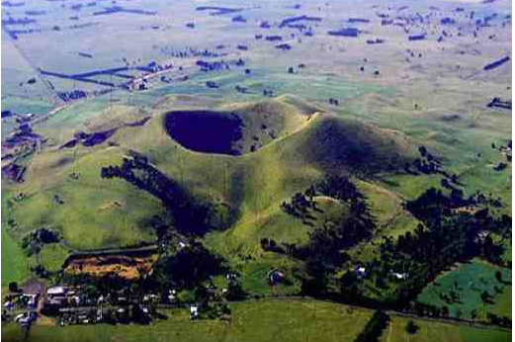
All about basalt
https://www.youtube.com/watch?v=ADN_GXgo3YY
The pale and glassy acid lava rhyolite/pumice is formed in subduction volcanoes. (PNG, White Island)
Bluestone/scoria/tuff is alkaline lava and formed
around here.(scoria cones,
crater lakes, stony rises)
Back to the history….

